Slide 1


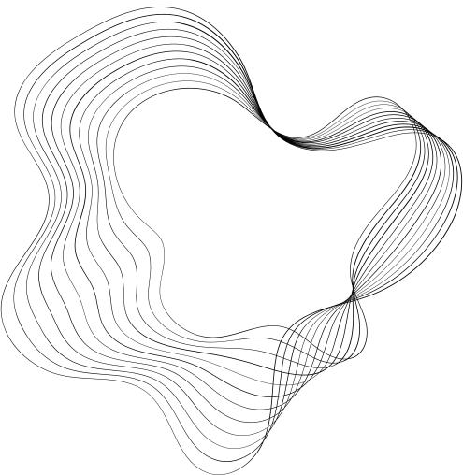
JAIN COLLEGE OF ENGINEERING BELAGAVI
?DEPARTMENT OF ELECTRONICS AND COMMUNICATION
GUIDE
DR. H P RAJANI
NAME : Baburao Sunthe
USN : 2JI21EC029

Slide 2


RADAR USING

Slide 3
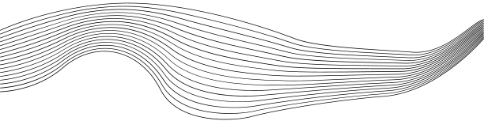
CONTENT
01
INTRODUCTION TO RADAR
02
INTRODUCTION TO ARDUINO
03
COMPONENTS
04
WORKING DIAGRAM
05
DEMONSTRATION
06
APPLICATIONS

Slide 4

INTRODUCTION TO RADAR:
Radar stands for Radio Detection and Ranging
It uses radio waves to determine the distance, angle, and velocity of objects..
Applications: aviation, weather monitoring, speed enforcement, and more.

Slide 5

INTRODUCTION TO ARDUINO:
Arduino is an open-source electronics platform based on easy-to-use hardware and software.
Key feature: Arduino boards can read inputs and turn them into outputs.
Pins- D0 to D13 Digital pins A0 to A5 Analog pins.

Slide 6
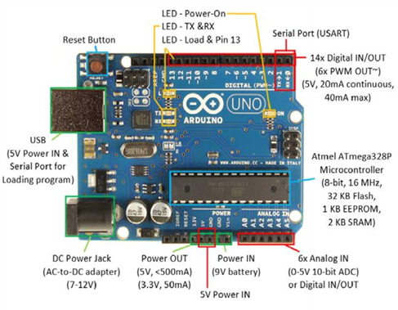

Slide 7
COMPONENTS:
Arduino Board: The main microcontroller unit.
Ultrasonic Sensor : Measures distance using sound waves.
Servo Motor: Rotates the sensor to scan the area.
Breadboard and Wires: For connecting components

Slide 8
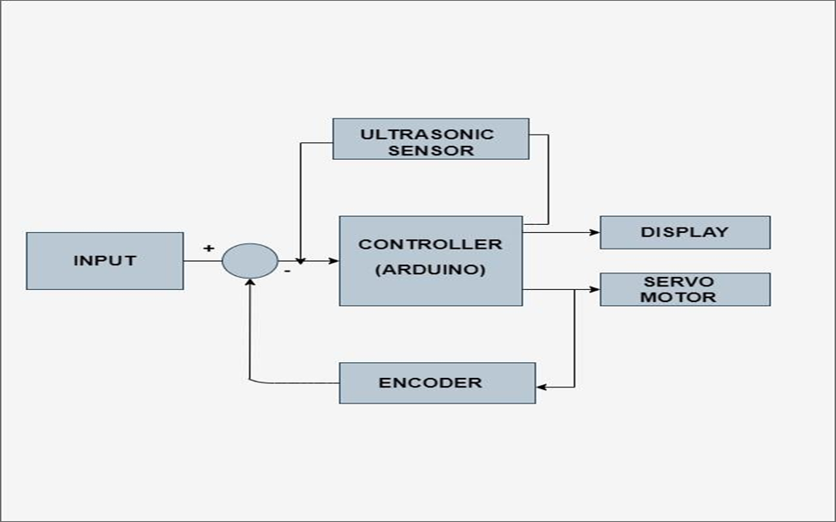
WORKING DIAGRAM:

Slide 9

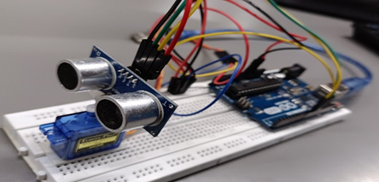
PROTOTYPE:

Slide 10

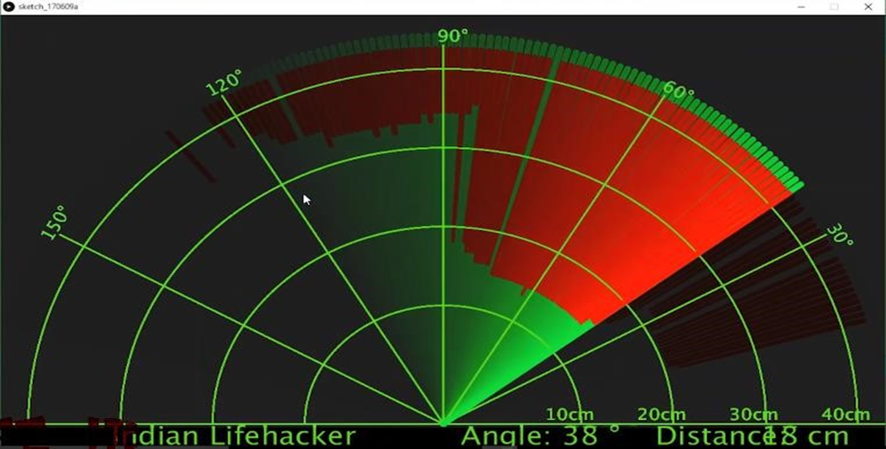
OUTPUT DEMONSTRATION:

Slide 11
APPLICATIONS:
simple security systems
Air Traffic Control
Aircraft Safety
Navigation
Obstacle detection for robots

Slide 12
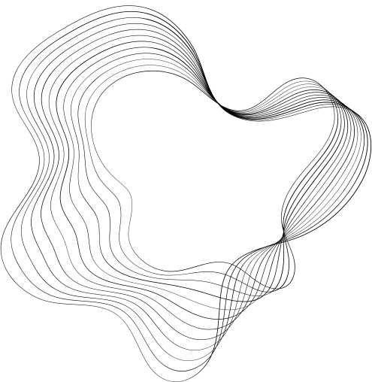
THANK YOU

